Slide 1
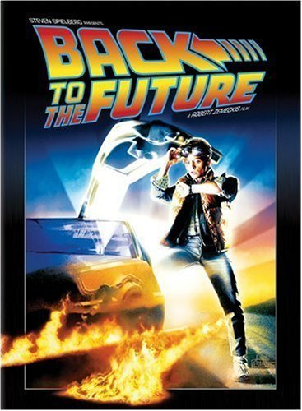
Parts of a Story
« Prev Next »

Slide 2
« Prev Next »

Slide 3
Plot:
the
EVENTS
that
happen in
a story

Slide 4
Rising Action:
the events that lead to the climax; the suspense, the tension

Slide 5
Climax:
the turning point—we learn what the outcome of the conflict is
Doc has to climb the clock tower to hook the wires up
Marty can’t get the car to start so he can go back to 1985
The car starts, hits the wire, and goes back to 1985

Slide 6
Falling Action:
the events that follow the climax; the wrap-up

Slide 7
Characters:
a person (or
animal) in a
story

Slide 8
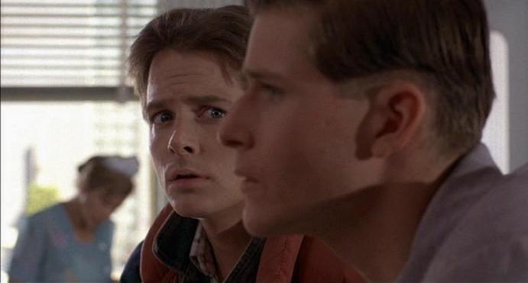
Conflict:
a struggle or
clash
between
opposing
characters
or forces; a
problem

Slide 9
Setting:
the time
AND place
where a
story takes
place

Slide 10
Theme:
what a
story has to
say about a
topic

Slide 11
Symbols:
a person,
place, thing,
or event that
stands for
itself and
something
beyond itself

