Slide 1
The Multiple-Paragraph Persuasive Essay
Master writing this, and you can write anything
GUARANTEED!

Slide 2
The Rewards of Mastering the Persuasive Essay
Got BYU to give me a half-tuition scholarship AFTER they said I didn’t apply
Helped my dad explain to the IRS why they shouldn’t fine him---they agreed
Sold many things on ksl.com: 1993 Suburu wagon, a 25-year-old toilet, motorcycle helmet, Kindle, juicer
Got me a job

Slide 3
Paragraph 1: Lead + Thesis Statement
Lead
Is the first impression
Hooks the audience
Sets the tone
Thesis Statement
Establishes your argument
Lists the argument’s supporting reasons (if appropriate)

Slide 4
Paragraph 2: Body Paragraph 1
Topic sentence
Corresponds to the FIRST reason listed in the thesis
Supporting sentences (5-7)
Are full of details: facts, personal experiences, quotations from reliable sources, or statistics.

Slide 5
Paragraph 3: Body Paragraph 2
Topic sentence
Corresponds to the SECOND reason listed in the thesis
Supporting sentences (5-7)
Are full of details: facts, personal experiences, quotations from reliable sources, or statistics.

Slide 6
Paragraph 4: Body Paragraph 3
Topic sentence
Corresponds to the THIRD reason listed in the thesis
Supporting sentences (5-7)
Are full of details: facts, personal experiences, quotations from reliable sources, or statistics.

Slide 7
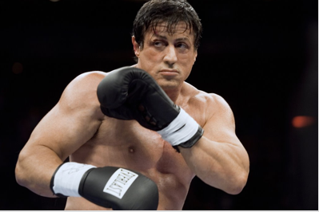
Paragraph 5: Refutation (or Rebuttal) in Five Easy Steps

Slide 8
Paragraph 5: Refutation (or Rebuttal)
1. Begin your refutation with—
Other people may argue . . . OR
Some people believe . . . OR
Opponents argue . . .
Some students believe

Slide 9
Paragraph 5: Refutation (or Rebuttal)
2. Complete the sentence with the other side’s position on the issue.
Some students believe that buying Ms. Palfreyman’s car is a good idea.

Slide 10
Paragraph 5: Refutation (or Rebuttal)
3. Then give the readers two arguments from the other side.
They believe this because it’s a good price and will be cheaper to insure than a newer car.

Slide 11
Paragraph 5: Refutation (or Rebuttal)
4. Then attack the opponents’ argument with a reason or with your thesis—start your attack with “However, . . . .”
However, Ms. Palfreyman’s car will require a lot of maintenance because of its age and engine problems. Any money that you save with its cost and the cost of insurance will be eaten up in repairs.

Slide 12
Paragraph 6: Conclusion
Restate thesis (keep reasons in the SAME order, but use slightly different words)
End with a sentence that keeps your audience thinking about your position and why it is right

